Slide 1
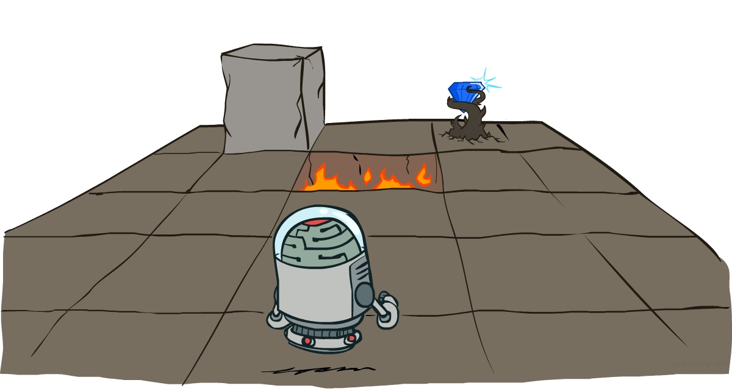
Fundamentals of Artificial Intelligence
Markov Decision Processes
Instructor: Dr. Hatim Alsuwat
Umm Al-Qura University

Slide 2
Expectimax Search
Why wouldn’t we know what the result of an action will be?
Explicit randomness: rolling dice
Unpredictable opponents: the ghosts respond randomly
Actions can fail: when moving a robot, wheels might slip
Values should now reflect average-case (expectimax) outcomes, not worst-case (minimax) outcomes
Expectimax search: compute the average score under optimal play
Max nodes as in minimax search
Chance nodes are like min nodes but the outcome is uncertain
Calculate their expected utilities
I.e. take weighted average (expectation) of children
Later, we’ll learn how to formalize the underlying uncertain-result problems as Markov Decision Processes
max
chance
10
10
4
10
5
9
7
100
[Demo: min vs exp (L7D1,2)]

Slide 3
Expectimax Pseudocode
def value(state):
if the state is a terminal state: return the state’s utility
if the next agent is MAX: return max-value(state)
if the next agent is EXP: return exp-value(state)
def max-value(state):
initialize v = -∞
for each successor of state:
v = max(v, value(successor))
return v
def exp-value(state):
initialize v = 0
for each successor of state:
p = probability(successor)
v += p * value(successor)
return v

Slide 4
Expectimax Pseudocode
def exp-value(state):
initialize v = 0
for each successor of state:
p = probability(successor)
v += p * value(successor)
return v
1/2
1/6
1/3
5
8
7
24
-12
v = (1/2) (8) + (1/3) (24) + (1/6) (-12) = 10

Slide 5
Expectimax Example
3
12
9
2
4
6
15
6
0

Slide 6
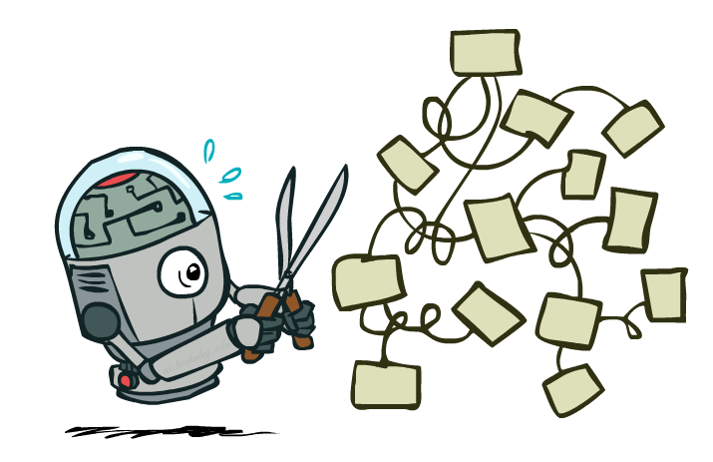
Expectimax Pruning?
3
12
9
2

Slide 7
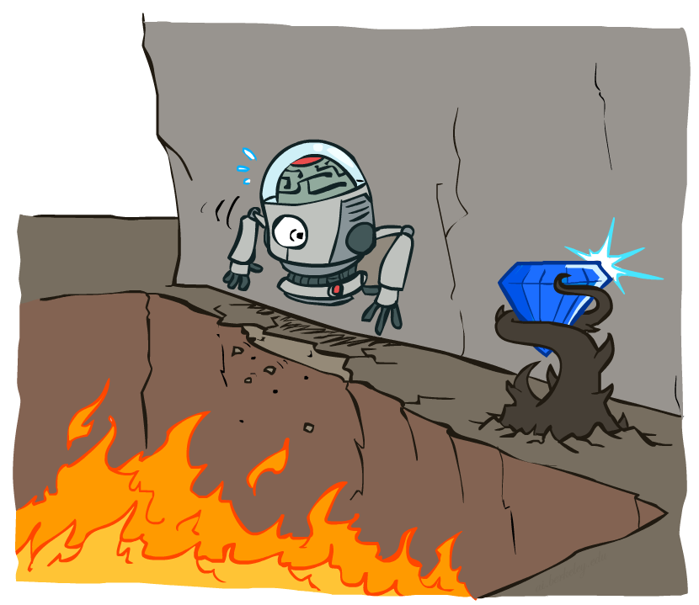
Non-Deterministic Search

Slide 8





Example: Grid World
A maze-like problem
The agent lives in a grid
Walls block the agent’s path
Noisy movement: actions do not always go as planned
80% of the time, the action North takes the agent North (if there is no wall there)
10% of the time, North takes the agent West; 10% East
If there is a wall in the direction the agent would have been taken, the agent stays put
The agent receives rewards each time step
Small “living” reward each step (can be negative)
Big rewards come at the end (good or bad)
Goal: maximize sum of rewards

Slide 9
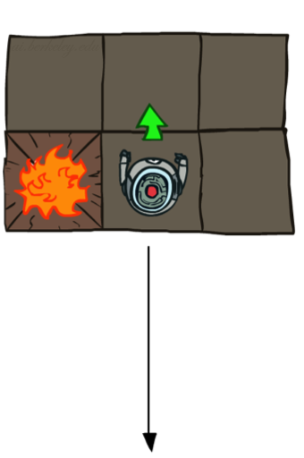
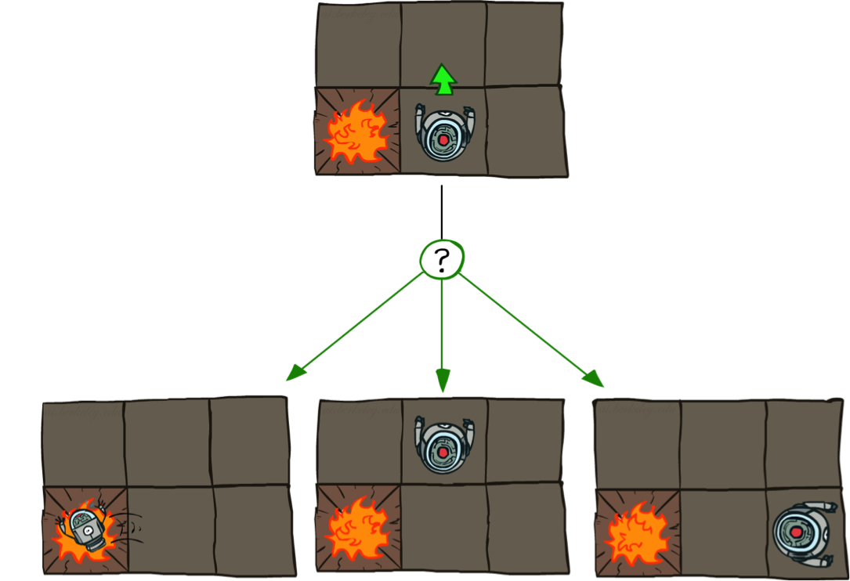

Grid World Actions
Deterministic Grid World
Stochastic Grid World

Slide 10
Markov Decision Processes
An MDP is defined by:
A set of states s ∈ S
A set of actions a ∈ A
A transition function T(s, a, s’)
Probability that a from s leads to s’, i.e., P(s’| s, a)
Also called the model or the dynamics
A reward function R(s, a, s’)
Sometimes just R(s) or R(s’)
A start state
Maybe a terminal state
MDPs are non-deterministic search problems
One way to solve them is with expectimax search
We’ll have a new tool soon
[Demo – gridworld manual intro (L8D1)]

Slide 11

Video of Demo Gridworld Manual Intro

Slide 12

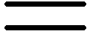
What is Markov about MDPs?
“Markov” generally means that given the present state, the future and the past are independent
For Markov decision processes, “Markov” means action outcomes depend only on the current state
This is just like search, where the successor function could only depend on the current state (not the history)
Andrey Markov (1856-1922)

Slide 13

Policies
In deterministic single-agent search problems, we wanted an optimal plan, or sequence of actions, from start to a goal
For MDPs, we want an optimal policy π*: S → A
A policy π gives an action for each state
An optimal policy is one that maximizes expected utility if followed
An explicit policy defines a reflex agent
Expectimax didn’t compute entire policies
It computed the action for a single state only
Optimal policy when R(s, a, s’) = -0.03 for all non-terminals s

Slide 14
Optimal Policies
R(s) = -0.01
R(s) = -0.03
R(s) = -0.4
R(s) = -2.0

Slide 15
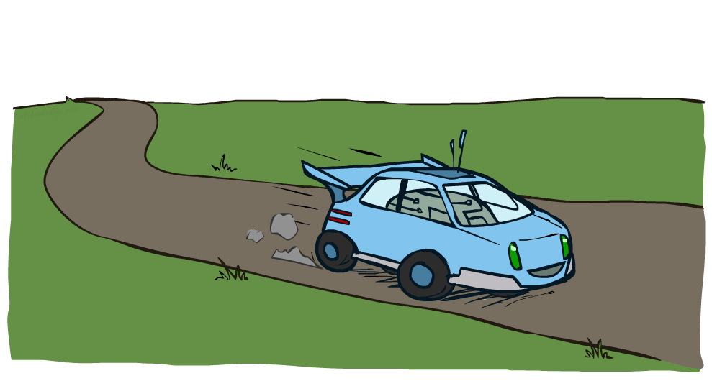
Example: Racing
Notes:
Lets look at another example.

Slide 16
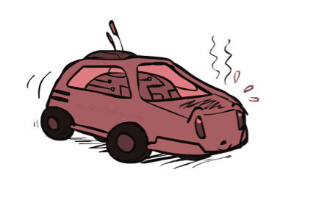
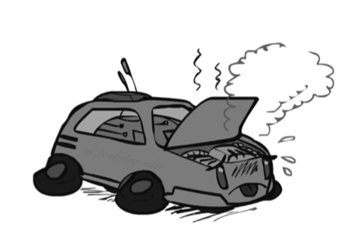
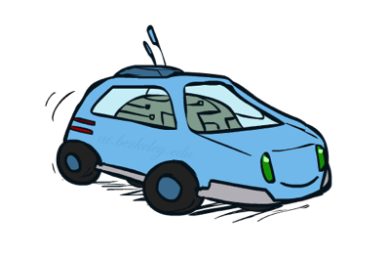
Example: Racing
A robot car wants to travel far, quickly
Three states: Cool, Warm, Overheated
Two actions: Slow, Fast
Going faster gets double reward
0.5
+1
1.0
Fast
Slow
-10
+1
0.5
Warm
Slow
Fast
0.5
+2
Cool
0.5
Overheated
+1
1.0
+2

Slide 17


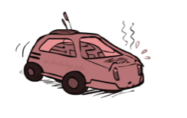
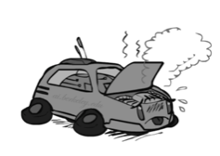
Racing Search Tree

Slide 18


MDP Search Trees
Each MDP state projects an expectimax-like search tree
s
s is a state
a
(s, a) is a q-state
s, a
(s,a,s’) called a transition
T(s,a,s’) = P(s’|s,a)
R(s,a,s’)
s,a,s’
s’

Slide 19
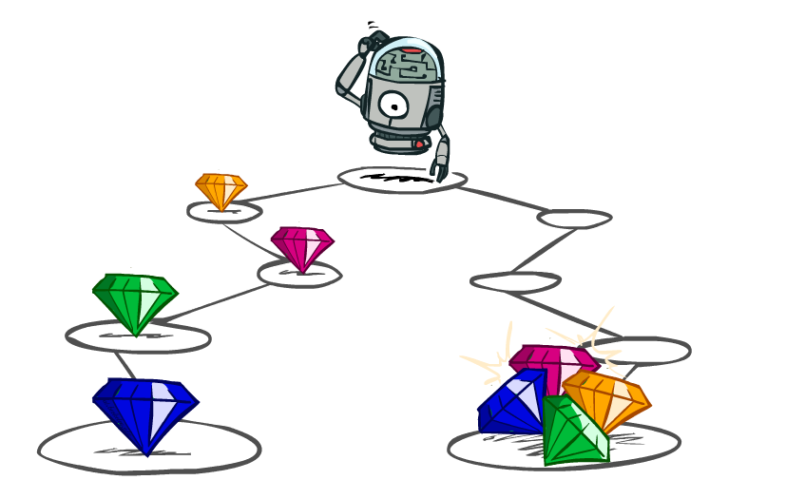
Utilities of Sequences

Slide 20
Utilities of Sequences
What preferences should an agent have over reward sequences?
More or less?
Now or later?
[1, 2, 2]
or
[2, 3, 4]
[0, 0, 1]
or
[1, 0, 0]

Slide 21




Discounting
It’s reasonable to maximize the sum of rewards
It’s also reasonable to prefer rewards now to rewards later
One solution: values of rewards decay exponentially
Worth Now
Worth Next Step
Worth In Two Steps

Slide 22

Discounting
How to discount?
Each time we descend a level, we multiply in the discount once
Why discount?
Sooner rewards probably do have higher utility than later rewards
Also helps our algorithms converge
Example: discount of 0.5
U([1,2,3]) = 1*1 + 0.5*2 + 0.25*3
U([1,2,3]) < U([3,2,1])

Slide 23
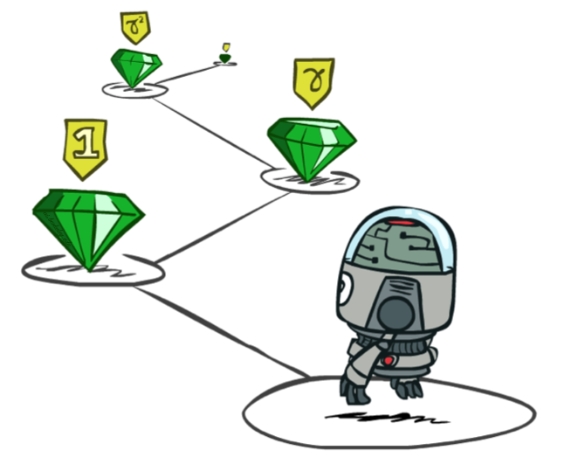
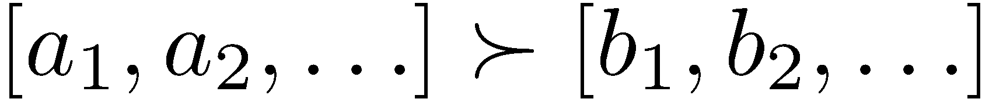
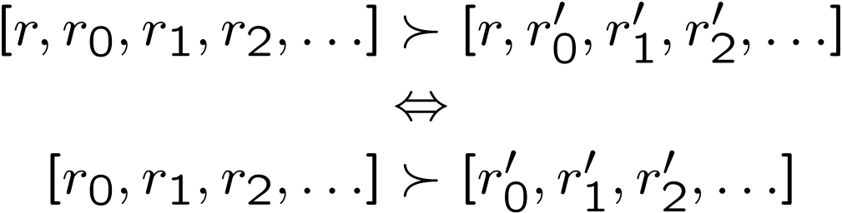
Stationary Preferences
Theorem: if we assume stationary preferences:
Then: there are only two ways to define utilities
Additive utility:
Discounted utility:

Slide 24

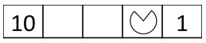
Quiz: Discounting
Given:
Actions: East, West, and Exit (only available in exit states a, e)
Transitions: deterministic
Quiz 1: For γ = 1, what is the optimal policy?
Quiz 2: For γ = 0.1, what is the optimal policy?
Quiz 3: For which γ are West and East equally good when in state d?

Slide 25
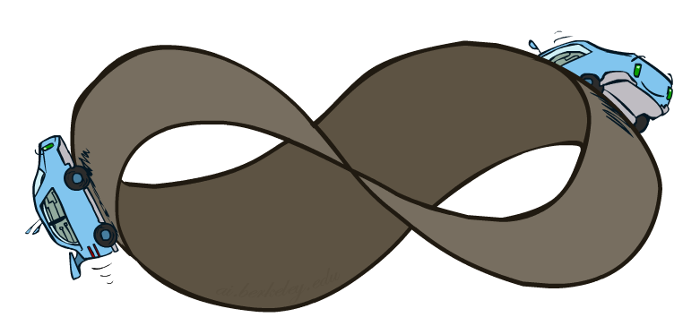
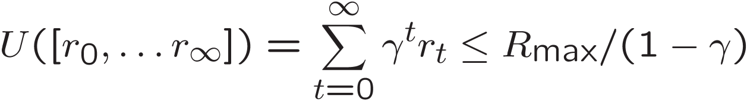
Infinite Utilities?!
Problem: What if the game lasts forever? Do we get infinite rewards?
Solutions:
Finite horizon: (similar to depth-limited search)
Terminate episodes after a fixed T steps (e.g. life)
Gives nonstationary policies (π depends on time left)
Discounting: use 0 < γ < 1
Smaller γ means smaller “horizon” – shorter term focus
Absorbing state: guarantee that for every policy, a terminal state will eventually be reached (like “overheated” for racing)

Slide 26
Recap: Defining MDPs
Markov decision processes:
Set of states S
Start state s₀
Set of actions A
Transitions P(s’|s,a) (or T(s,a,s’))
Rewards R(s,a,s’) (and discount γ)
MDP quantities so far:
Policy = Choice of action for each state
Utility = sum of (discounted) rewards
s
a
s, a
s,a,s’
s’

Slide 27
Solving MDPs

Slide 28
Optimal Quantities
The value (utility) of a state s:
V*(s) = expected utility starting in s and acting optimally
The value (utility) of a q-state (s,a):
Q*(s,a) = expected utility starting out having taken action a from state s and (thereafter) acting optimally
The optimal policy:
π*(s) = optimal action from state s
s
s is a state
a
(s, a) is a q-state
s, a
s,a,s’
(s,a,s’) is a transition
s’
[Demo – gridworld values (L8D4)]

Slide 29
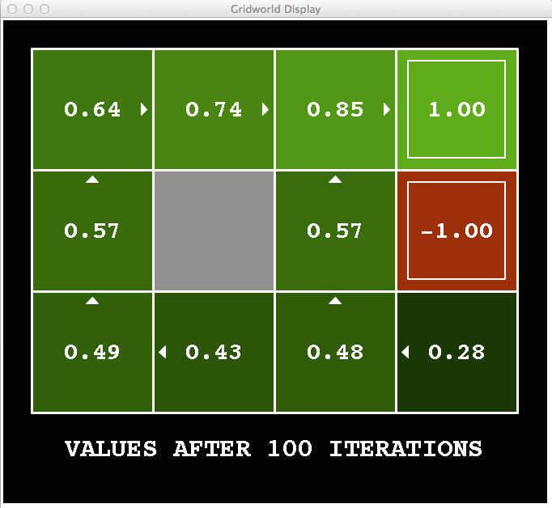
Snapshot of Demo – Gridworld V Values
Noise = 0.2
Discount = 0.9
Living reward = 0

Slide 30
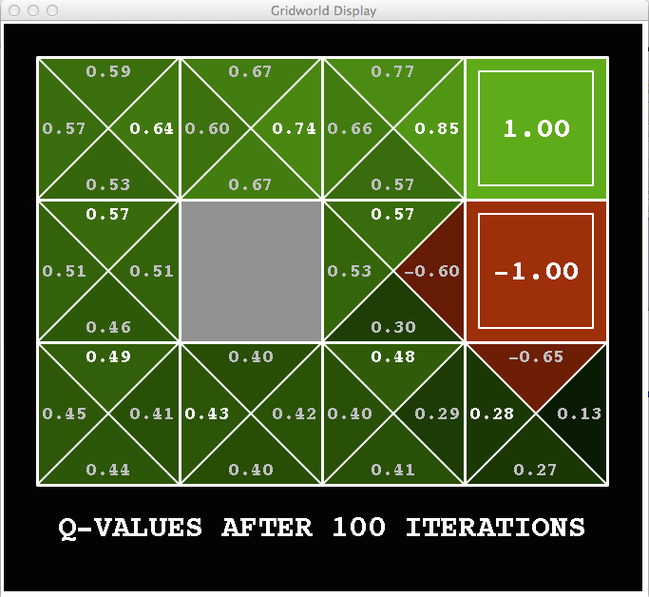
Snapshot of Demo – Gridworld Q Values
Noise = 0.2
Discount = 0.9
Living reward = 0

Slide 31


Values of States
Fundamental operation: compute the (expectimax) value of a state
Expected utility under optimal action
Average sum of (discounted) rewards
This is just what expectimax computed!
Recursive definition of value:
s
a
s, a
s,a,s’
s’

Slide 32
Racing Search Tree

Slide 33


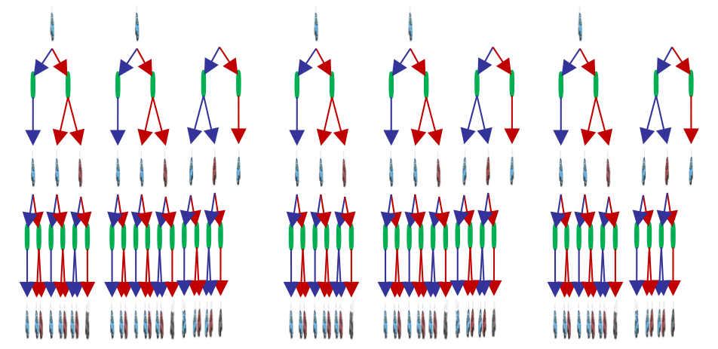
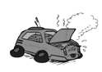
Racing Search Tree

Slide 34
Racing Search Tree
We’re doing way too much work with expectimax!
Problem: States are repeated
Idea: Only compute needed quantities once
Problem: Tree goes on forever
Idea: Do a depth-limited computation, but with increasing depths until change is small
Note: deep parts of the tree eventually don’t matter if γ < 1

Slide 35


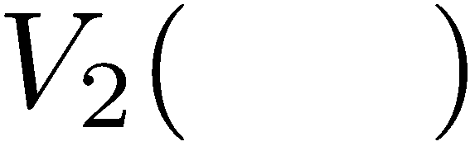

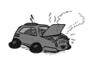
Time-Limited Values
Key idea: time-limited values
Define V_{k}(s) to be the optimal value of s if the game ends in k more time steps
Equivalently, it’s what a depth-k expectimax would give from s
[Demo – time-limited values (L8D6)]

Slide 36
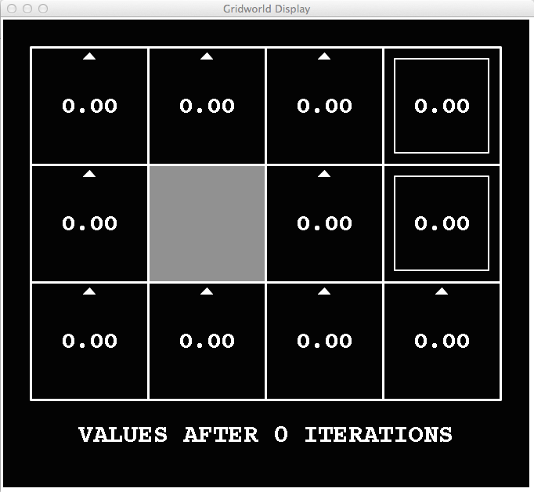
k=0
Noise = 0.2
Discount = 0.9
Living reward = 0

Slide 37
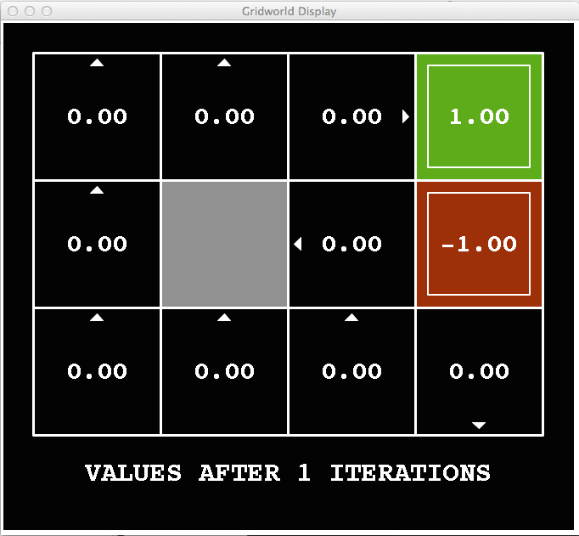
k=1
Noise = 0.2
Discount = 0.9
Living reward = 0

Slide 38
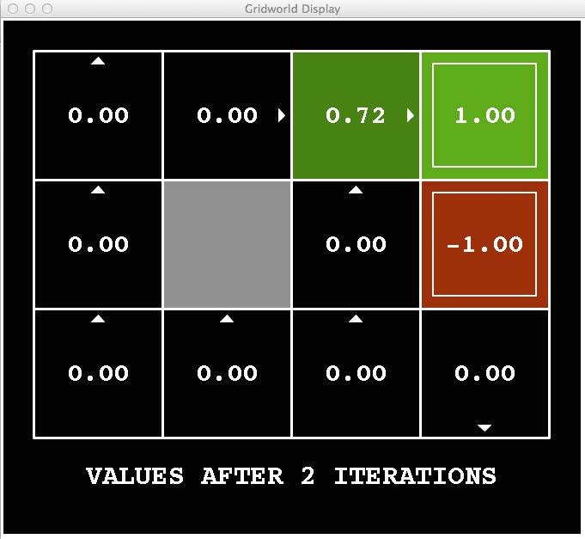
k=2
Noise = 0.2
Discount = 0.9
Living reward = 0

Slide 39
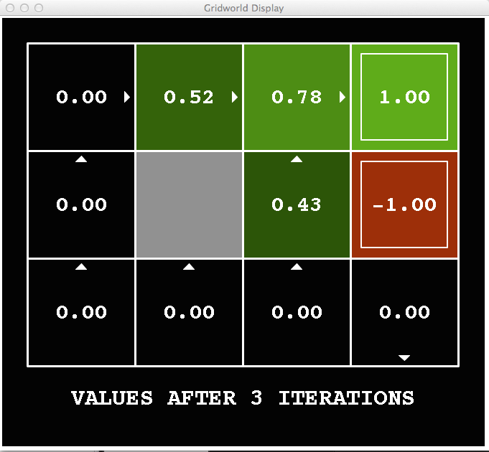
k=3
Noise = 0.2
Discount = 0.9
Living reward = 0
Notes:
Assuming zero living reward

Slide 40
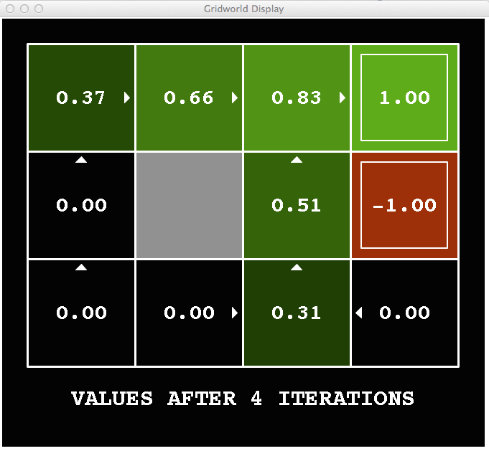
k=4
Noise = 0.2
Discount = 0.9
Living reward = 0
Notes:
Assuming zero living reward

Slide 41
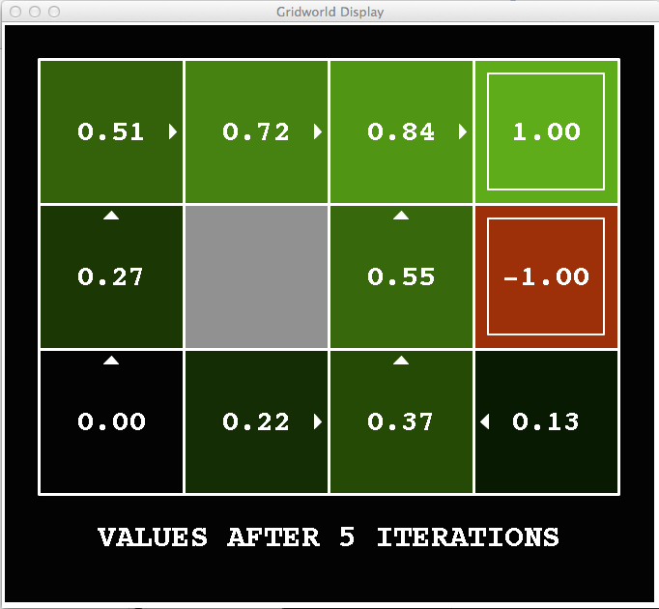
k=5
Noise = 0.2
Discount = 0.9
Living reward = 0
Notes:
Assuming zero living reward

Slide 42
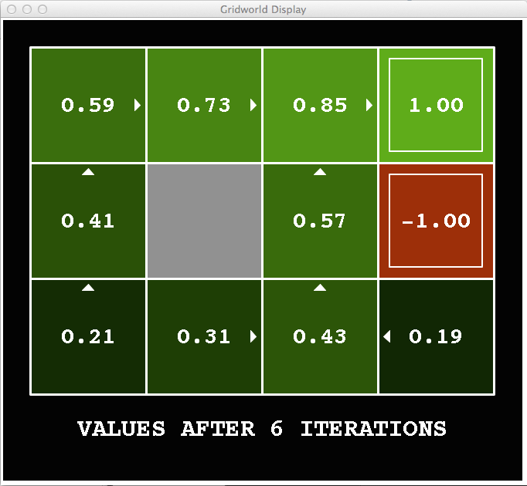
k=6
Noise = 0.2
Discount = 0.9
Living reward = 0
Notes:
Assuming zero living reward

Slide 43
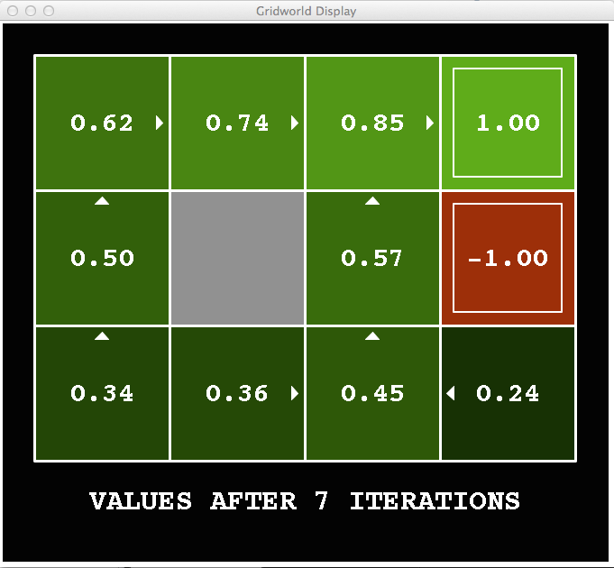
k=7
Noise = 0.2
Discount = 0.9
Living reward = 0
Notes:
Assuming zero living reward

Slide 44
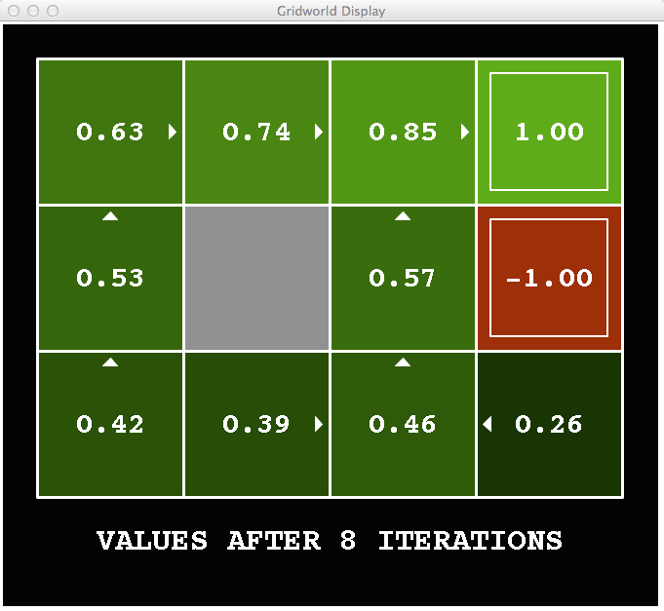
k=8
Noise = 0.2
Discount = 0.9
Living reward = 0
Notes:
Assuming zero living reward

Slide 45
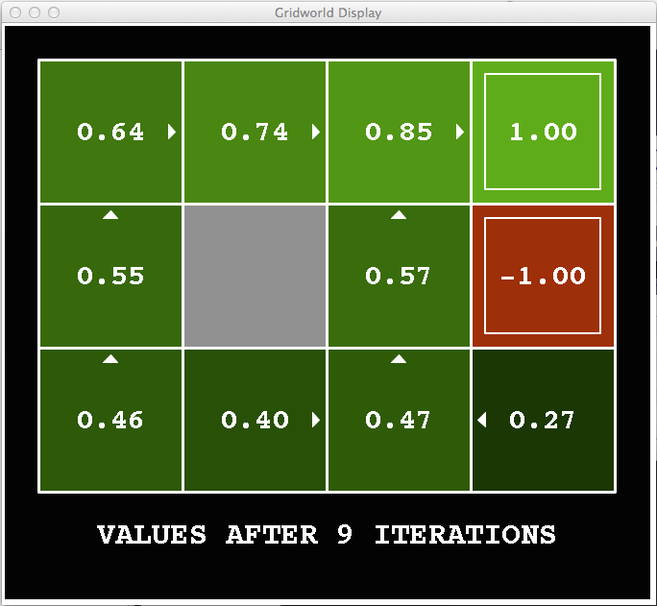
k=9
Noise = 0.2
Discount = 0.9
Living reward = 0
Notes:
Assuming zero living reward

Slide 46

k=10
Noise = 0.2
Discount = 0.9
Living reward = 0
Notes:
Assuming zero living reward

Slide 47

k=11
Noise = 0.2
Discount = 0.9
Living reward = 0
Notes:
Assuming zero living reward

Slide 48

k=12
Noise = 0.2
Discount = 0.9
Living reward = 0
Notes:
Assuming zero living reward

Slide 49

k=100
Noise = 0.2
Discount = 0.9
Living reward = 0
Notes:
Assuming zero living reward

Slide 50
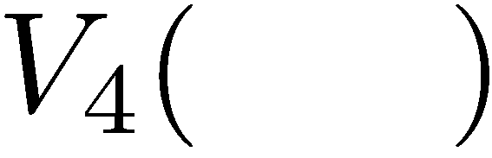

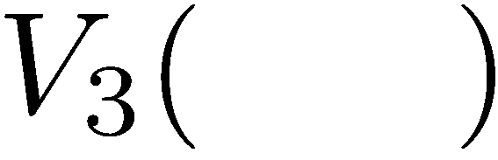
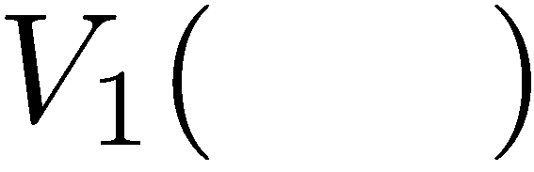
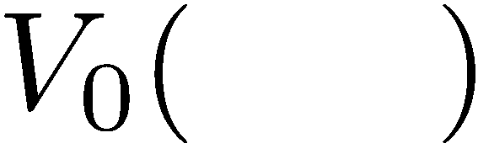
Computing Time-Limited Values

Slide 51
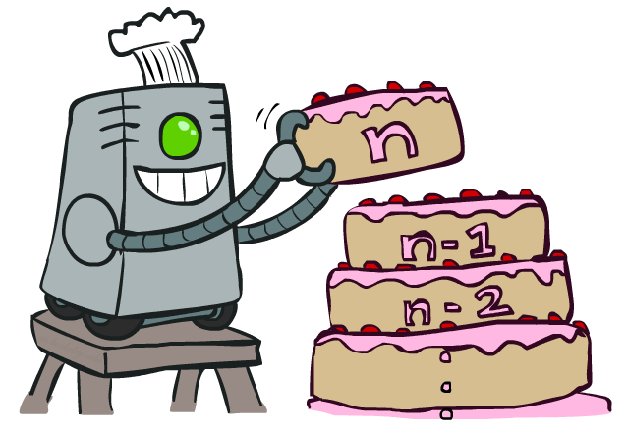
Value Iteration

